Slide 1
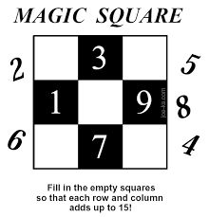
Topic: Square Numbers
EQ: Describe how the area of a square gives us square numbers?

Slide 2
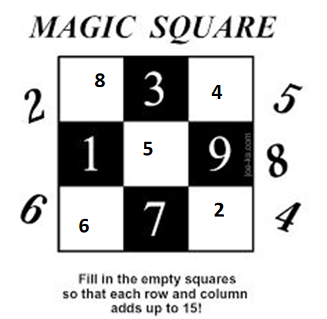

Slide 3
Task One
Draw 5 squares with different side lengths on the square paper.
Calculate the area of each square

Slide 4
24
7
30
Date
Square Numbers
EQ – Describe how the area of a square gives us square numbers?
How do I find the area of a square?
9

Slide 5
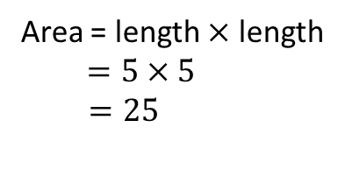
24
7
30
Date
Square Numbers
EQ – Describe how the area of a square gives us square numbers?
How do I find the area of a square?
Area = 25
Area = length $×$ length
$$=5×5$$
$=25$
5
This shows us that 25 is a square number.
9

Slide 6
Task Two
What square numbers did you find in the first task?
Give one / Get one - Share answers with peers.

Slide 7
Task Two
What square numbers did you find in the first task?
Give one / Get one - Share answers with peers.
Prepare to share one with the class.
Lesson
Demo

Slide 8
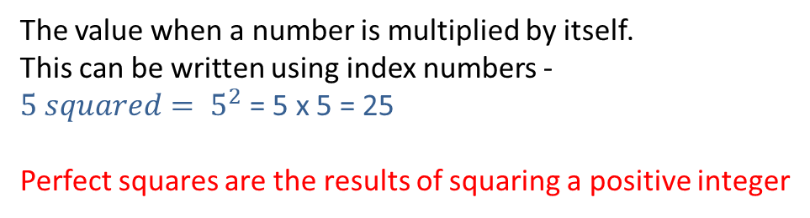
24
7
30
Date
Square Numbers
EQ – Describe how the area of a square gives us square numbers?
How do I find the area of a square?
Area = 25
Area = length $×$ length
$$=5×5$$
$=25$
5
This shows us that 25 is a square number.
How do I square a number?
The value when a number is multiplied by itself.
This can be written using index numbers -
${5 squared= 5}^{2}$ = 5 x 5 = 25
Perfect squares are the results of squaring a positive integer
9

Slide 9


Calculate the following
$1^{2}=1×1=1$
$2^{2}$
$3^{2}$
$4^{2}$
$5^{2}$
$6^{2}$
$7^{2}$
$8^{2}$
$9^{2}$
${10}^{2}$
${11}^{2}$
${12}^{2}$

Slide 10
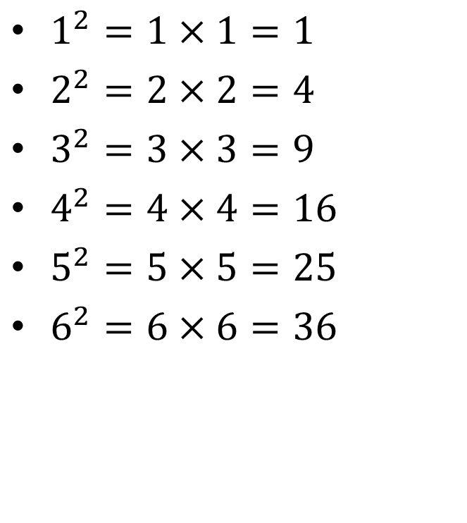
Calculate the following
$1^{2}=1×1=1$
$2^{2}=2×2=4$
$3^{2}=3×3=9$
$4^{2}=4×4=16$
$5^{2}=5×5=25$
$6^{2}=6×6=36$
$7^{2}$
$8^{2}$
$9^{2}$
${10}^{2}$
${11}^{2}$
${12}^{2}$

Slide 11
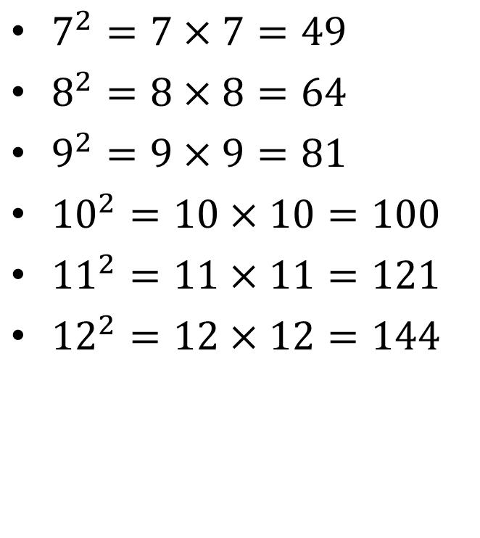
Calculate the following
$1^{2}=1×1=1$
$2^{2}=2×2=4$
$3^{2}=3×3=9$
$4^{2}=4×4=16$
$5^{2}=5×5=25$
$6^{2}=6×6=36$
$7^{2}=7×7=49$
$8^{2}=8×8=64$
$9^{2}=9×9=81$
${10}^{2}=10×10=100$
${11}^{2}=11×11=121$
${12}^{2}=12×12=144$

Slide 12
Sentence Frame
Summary:
Today we learnt about ________.
The area of a square gives us a ________ number.
A square number can also be found by ________ any number by ________.
Eg. 2 X 2 = ____ = ____

Slide 13
Homework
Review your notes and write a summary answering the essential question.

